Slide 1
Colorless Metro
Routing and Switching Architecture

Slide 2
What problems are we trying to solve
Both the iLEC and Metro 2.0 networks are cost optimized for 1G Services
We need to invest to scale the Metro for 10G and 100G Services – we can’t afford to strategically invest in both
Cell Site backhaul (VZ, AT&T, T-Mob ~ 18K ports) will require upgrade from 1G to 10G within 2+yrs
2700 wire centers in iLEC metro support cell cite backhaul
T-Mobile has ~4800 tower in ~1600 Wire center
100G metro require to support 10G Tower
4% of the Current iLEC Wire center are 100G
70% of VZ, AT&T, T-Mobile towers are same Serving Wire Centers
Analysis of supporting T-Mobile cell site backhaul upgrade
iLEC - $500M+
Colorless $150M < $200M
Minimize development and reliance on iLEC OSS systems
Eliminate duplicity of network and hardware (NIDs) , truck rolls and streamline Access

Slide 3
Colorless Metro - Strategy
Grow Metro 3.0 as strategic colorless Metro and develop support for “all growth” services
iLEC Metro will continue to support existing services and speeds - consumer available port capacity
Grow new and higher speed 10G/100G service on Metro 3.0
Interconnect the Metro with BGP-LU / Option-C NNI – allows service interoperability with a common “Route Target”
Deploy 100G Ethernet Collector Node (ECN) in each iLEC wire center
Use existing (Orange) systems and process to deploy ECN into the Wire center
Use Inter office Fiber to build 400G and 100G ECNs into the iLEC Wire center
Use the iLEC lateral fiber to deploy 10G NID over single fiber to the customer/Cell site towers
A port/UNI on a NID can be iLEC (green) or National (Red/Blue/Orange/Green) – colorless
Two touch service provisioning
Node A - ILEC MER/MGR - use existing iLEC provision systems
Node B - Metro Edge (3.0) – use go forward provisioning and automation
Automates performance testing Y.1731 , Service turn-up Y.1564
Add new Metro 3.0/iLEC Node inventoried in iLEC systems (barebones/black box)
Develop a sync-Engine to reconcile inventory between National ARM ( ASPI ) and iLEC ARM
Real time Reconciliation of port inventory and Customer Facing Service (CFS)
New/Existing iLEC services can be design to new Metro 3.0 – fully interoperable to iLEC
Support wireless backhaul , Wholesale Ethernet, MOE services

Slide 4


BGP-LU for colorless
BGP-LU provides reachability between iLEC and Metro 3.0 by advertising PE loopbacks
BGP-LU in turn advertises the loopbacks and label bindings to remote MEs/MERs/MGR between the iLEC and metro Nodes
BGP-Address Family (SAFI) L2VPN – advertises VPLS Route targets
BGP-LU NNIs would replace FIN-E NNIs in Metro Markets – existing Services would be migrated
BGP-L2VPN
BGP-L2VPN
MC
MC
BGP-LU
MGR-3
BGP-L2VPN
BGP-RR
Nx100G
BGP-RR
ILEC
MER-2
Metro 3.0
Nx100G
MGR
MER-1
BGP-LU
Device | loopback | BGP-Label Unicast
ME3-1 | 1.1.1.1 | 1999345
ME3-2 | 1.1.1.2 | 1999347
ME3-3 | 1.1.1.3 | 1999386
Device | Loopback | BGP-Label Unicast
MER-1 | 10.2.2.1 | 2001342
MER-2 | 10.2.2.2 | 2002343
MGR-1 | 10.2.2.3 | 2003344
BGP-LU
BGP-LU

Slide 5
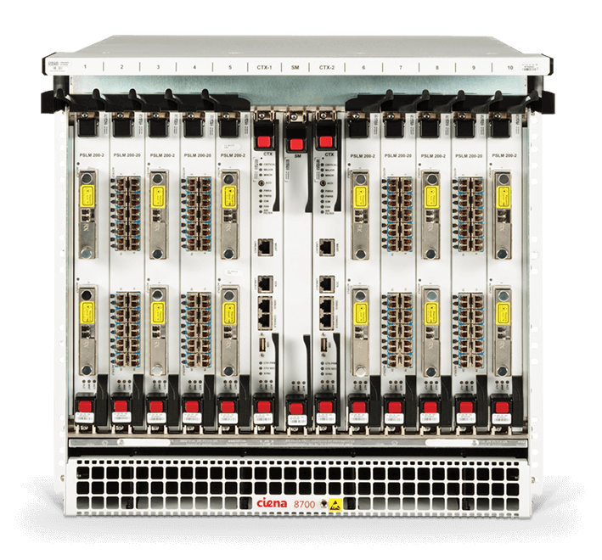
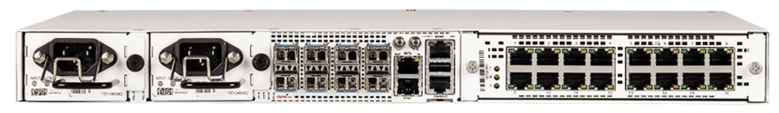

Cell Site backhaul and colorless – priority #1
Target is to support this design in 1H2021
Upgrade iLEC MTSO handoff to 100G
Build option-C 100G NNI between metro 3.0 and iLEC
Build 100G Metro 3.0 network to Wire center on Inter office Fiber
Deploy ECN to the Wire center
Overbuild 10G NID to tower on iLEC F1/F2 Fiber
Build VPLS service from MTSO(s) to ECN/NID
Migrate from 1G to 10G
Complete T-mobile upgrade by End of 2023
T-Mobile MSC
T-Mobile MSC
8700
NID
8700
NID
100G upgrades already complete/near complete from previous T-Mobile requirement
MER or MGR
MER or MGR
MCR
MCR
MCR
MGR
MGR
ILEC Waves
MER
MER
ILEC
vs
Metro 3.0
(colorless)
Metro 3.0/ECN

Slide 6
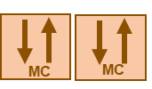
Metro Direct + Metro Pop diversity - Priority#2
Metro Direct – LAG and Transport Diversity – simple and scalable
Pop Diversity – Support Service Redundancy / PE redundancy
Metro Ring Diversity – Metro 3.0 will allow Ring to span between Pop/GWs
MPLS (3549)
Internet (3356)
MPLS (209)
Metro Direct Transport + LAG redundancy
BGP-RR
BGP-LU
BGP-L2VPN
MGR-3
Pop#1
Pop#2
Nx100G
BGP-RR
ILEC
MER-2
Metro 3.0
Nx100G
MGW
MGR
MER-1
BGP-LU

Slide 7
Colorless Metro – Roadmap
HLD for Colorless Metro – published last Month
T-Mobile 10G Tower upgrade Business Case – based on Colorless
IT developing an OSS and BSS LOE and present to Leadership team
10G NID RFP in progress lower the cost of NID from ~ $1500 to $500 – Target for completion 2H21
Indoor and Outdoor Variants
10G and 100G Variants
Dual Vendor NID strategy
Programmability Direct to device API
Metro hardware RFP - Target for completion 2H21
100G and 400G Metro Core and Distribution
Spine Leaf/Ring design for scale
Segment Routing with VPLS - EVPN in future
Lower the $/G < $10, iLEC is currently ~ $60
Programmability Direct to device API

Slide 8
Cell Site MTSO on Colorless – priority #2
T-Mobile MSC
T-Mobile MSC
T-Mobile MSC
T-Mobile MSC
8700
NID
M3
M3
M3
M3
NCS
-
5501
NCS
-
5501
NCS
-
5501
NCS
-
8700
NID
5501
MER or MGR
MER or MGR
MCR
MCR
MCR
MGR
MGR
MCR
MCR
ILEC Waves
ILEC Waves
MER
MER
Metro 3.0/ECN
Metro 3.0/ECN
MER
MER
ILEC MTSO
iLEC Metro with 3 G EVC/10G UNI
ILEC MTSO
Metro 3.0 with 10G EVC/10G UNI
Metro 3.0 MTSO
iLEC Metro with 3 G EVC/10G UNI
Metro 3.0 MTSO
Metro 3.0 with 10G EVC/10G UNI

Slide 9

Colorless Metro Development Roadmap
PI12
PI11
PI10
Q2 2022+
Approved Projects / Already Underway
PI9
Q1 2022
PI8
Future Phases / Pending Approval
Q4 2021
Target Launch
Q3 2021
Q2 2020
Metro Features
Colorless HLD
BGP-LU support for iLEC-Metro3.0
M3 for MTSO Head end
BGP/VPLS for ECN
10G Port based Dual EVCs on 10G NID
NetDev
systems
Service Config for NID/ECN
Service Config Low cost 10G NID (RFP)
Cell site backhaul Y.1731
Service Config 100G ECN/M3 (RFP)
Cell site backhaul Y.1564 T&T
Service Config M3 MTSO
Metro Hardware
400G/100G MCR/MDR ( RFP)
M3 Large – Dense 100G (RFP)
Low cost 10G NID (RFP)
Second vendor 100G ECN/M3 (RFP)
LOE – IT DEV
Dev TIRKS / ARM /OminVue
Sync Engine

